Slide 1
Our 50 States: Rhode Island
Molly
July 2015

Slide 2
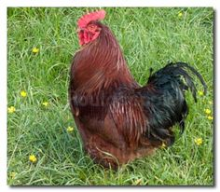
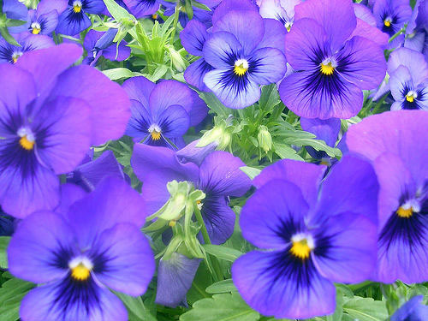
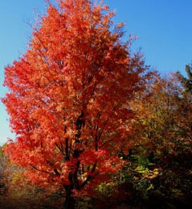
Symbols of Rhode Island
The state bird is: The Rhode Island Red
The state flower is: violet
The state tree is: red maple
Add a picture here.
Add a picture here.
Add a picture here.

Slide 3
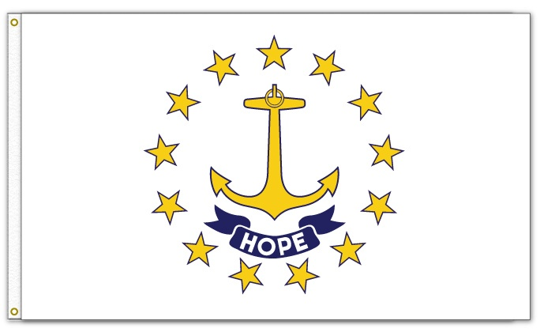
State Flag
The Rhode Island flag stands for the Rhode Island seal and a special quote: “Hope we have to the anchor of the soul.”
Add a picture here.

Slide 4
State Nickname
The state’s nickname is the Ocean State because Rhode Island has two border states and the rest is water.

Slide 5
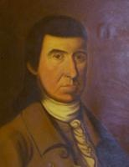
Statehood
This state became the 13th state in the United States in 1790.
The first Governor of the state was Nicholas Cooke.

Slide 6
Government
Gina Raimondo is the governer.

Slide 7
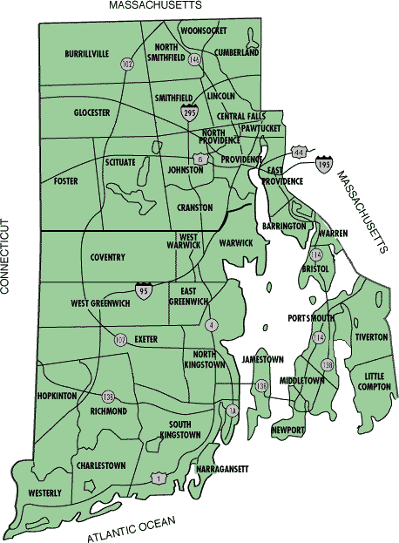
Maps

Slide 8
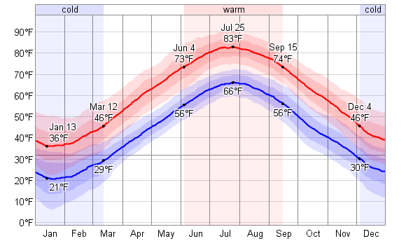
Weather
The average high temperature in July is: 83 degrees Fahrenheit
The average high temperature in January is: 36 degrees Fahrenheit

Slide 9
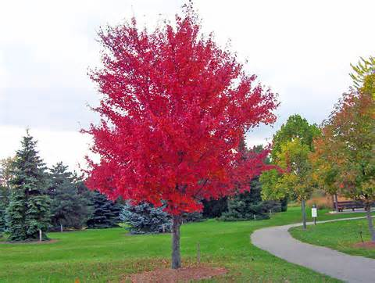
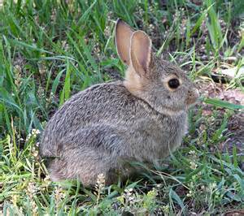
Natural Resources
Plant Life
maple trees, violets, and evergreens
Animal Life
coyotes, raccoons, skunks, and rabbits

Slide 10
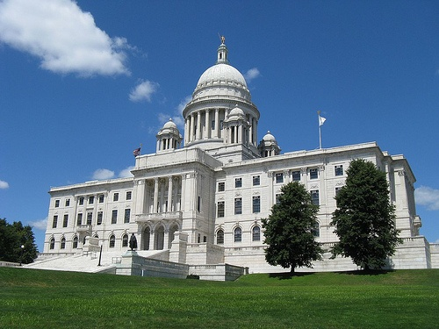
Places to Visit
If I were to visit, I would like to visit the Rhode Island state house because I would like to get some background information on a new state and I could find some good information also.

Slide 11
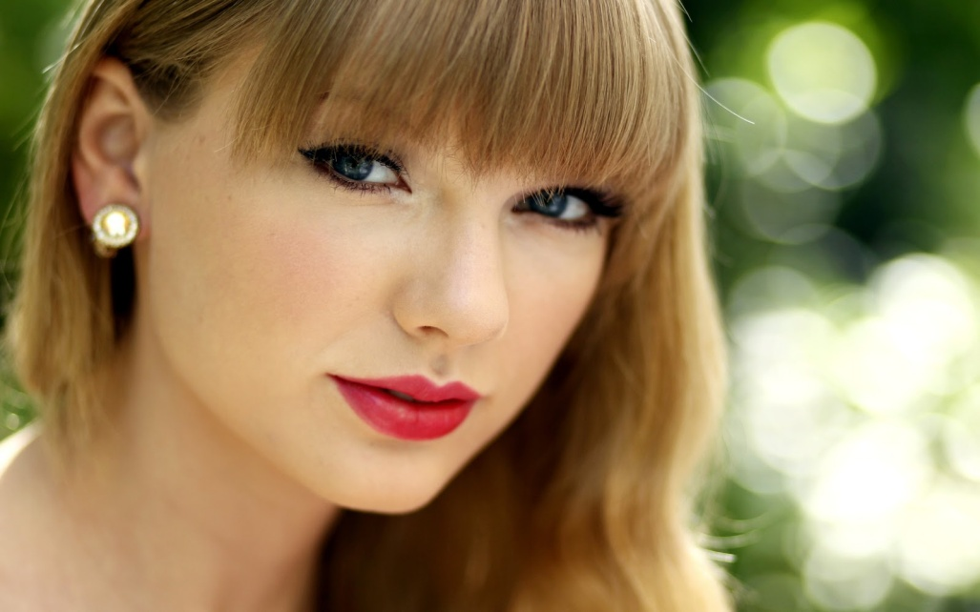
Famous People
Taylor Swift
Robert Capron
Elisabeth Hasselbeck

