Slide 1
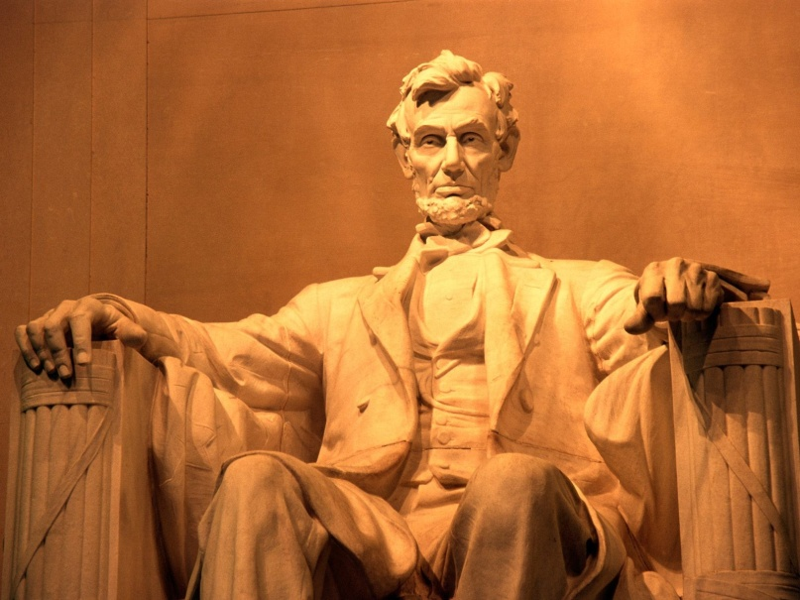
Abraham Lincoln
By: Kristina

Slide 2
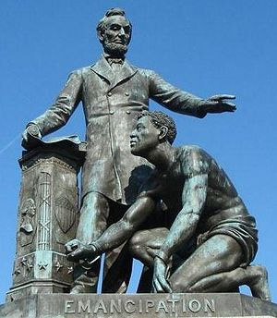
What is he famous for?
Abraham Lincoln was the 16th president of the United States.
He also freed slaves.

Slide 3
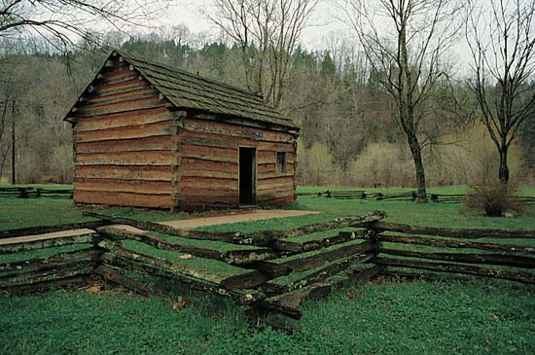
Early Life
Abraham Lincoln was born on February 12, 1809 in a log house in Kentucky.
During his childhood Abe enjoyed reading.
Also, his family moved north.

Slide 4
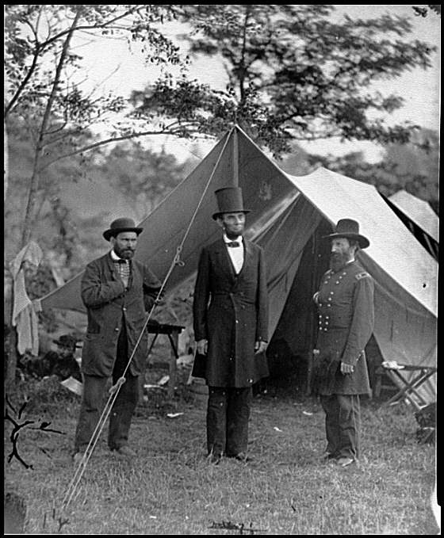
Fun Facts
At age 19 Abe was 6 feet and 4 inches tall.
Abe split logs.
People called him “Honest Abe.”
He was the 16th president.
He made a famous speech in
Gettysburg.

