Slide 1
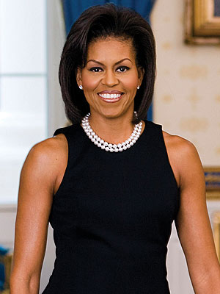
Michelle Obama
By Juliet

Slide 2
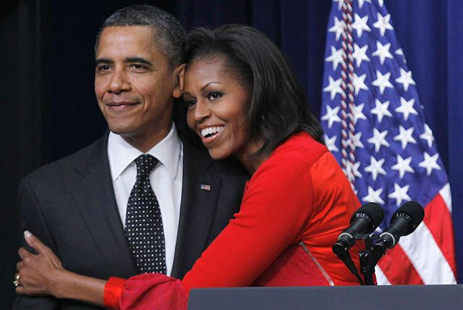
What is she famous for?
This person is famous for being the first lady.

Slide 3
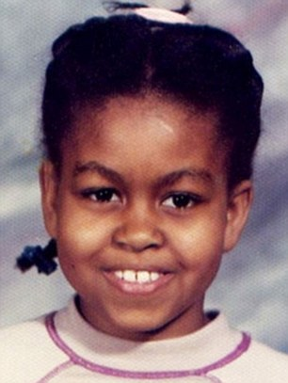
Birth and Family
Michelle Obama was born on January 17, 1964.
She was born in Chicago, Illinois.
Her parents are Marion Robinson and Fraser Robinson
She had 1 brother named Craig.

Slide 4
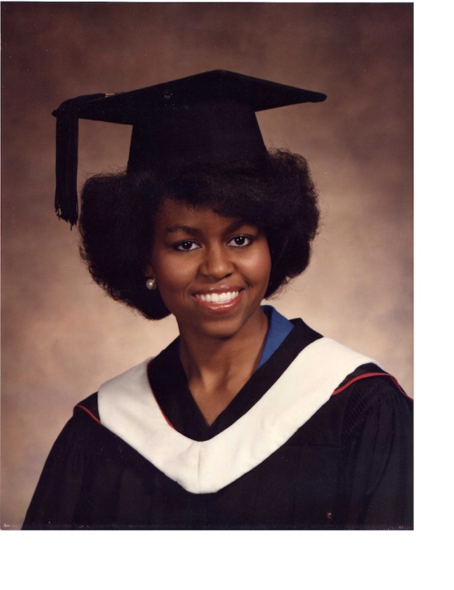
Early Life
Michelle went to Whitney M. Young Magnet High School.
For college she went to Princeton University in New Jersey.

Slide 5
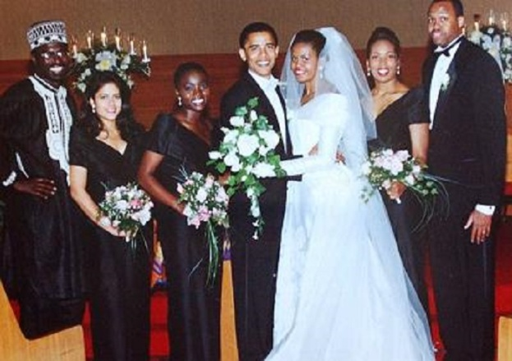
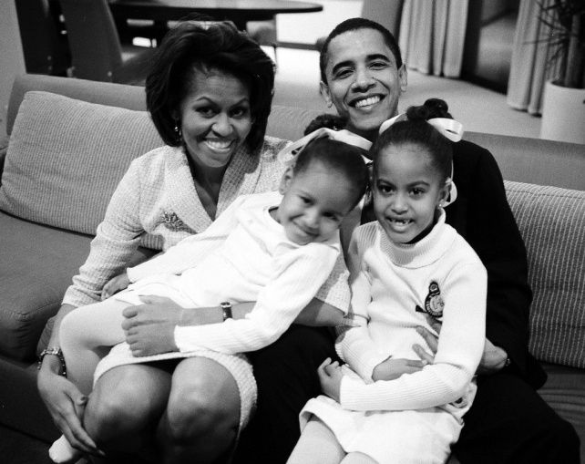
Adult Life
She got married in 1992 to Barack Obama.
Michelle had her first daughter Malia in 1998.
She had her last daughter Sasha in 2001.

