Slide 1
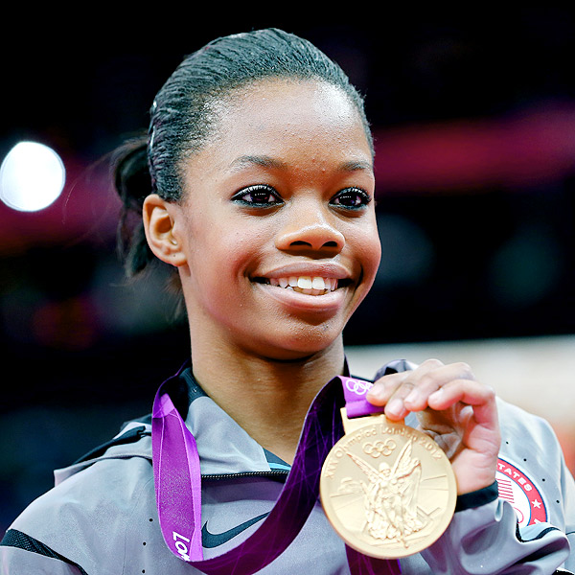
Gabby Douglas
By Ellie

Slide 2
Why is this person famous?
She is famous because she is a strong and awesome gymnast.

Slide 3
Birth
She was born on December 31, 1995.
She was born in Virginia Beach, Virginia.
Parents: Natalie (Mom) Timothy(Dad)
Siblings: Arielle (older)

Slide 4
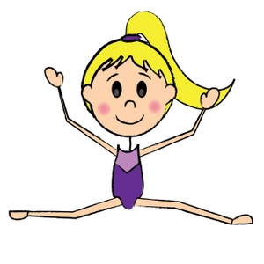
Early Life
Education: Arielle said she was very flexible and was able to do splits just in day one.
Interests: gymnastics
Other Important facts: She moved near Des Moines, Iowa to train with a guy named Laing Chow.

Slide 5
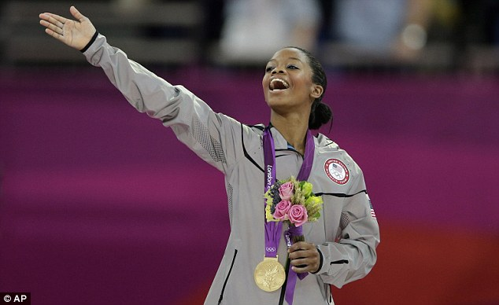
Adult Life
She won 4 gold medals.
She was the first African American to win all of them.
She helped team USA finish first in the world gymnastic championship.

