Slide 1
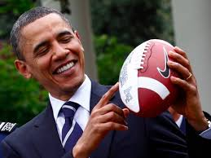
Barack Obama
By Collin

Slide 2
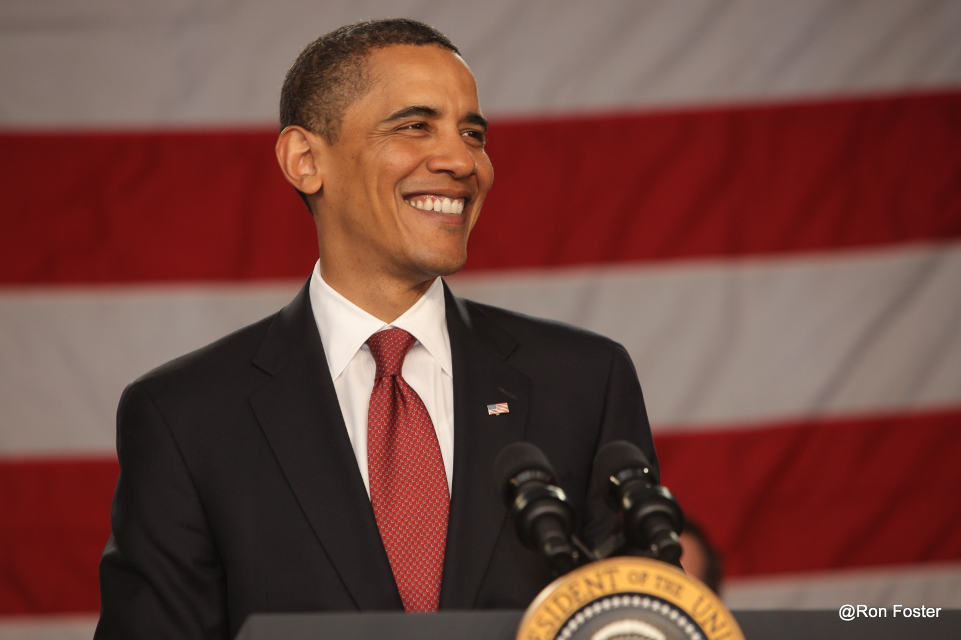
What is he famous for?
He is the President of the United States of America.

Slide 3
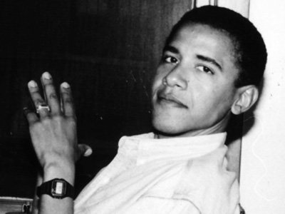
Early Life
Barack was born on August 10, 1961.

Slide 4
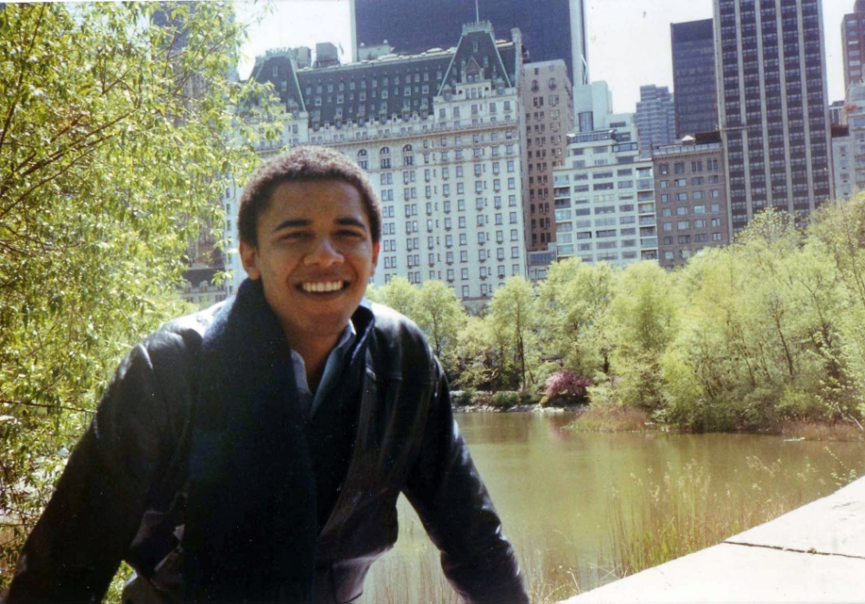
Fun Facts
Obama moved to Chicago and helped the Altegeld Gardens housing project people make their community safer.
At Columbia University Obama began going by Barack instead of Barry.
Obama was a professor.

