Slide 1
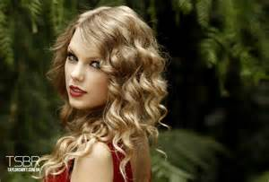
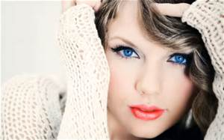
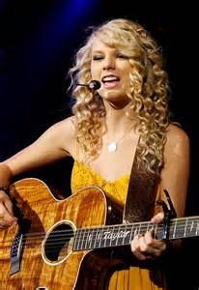
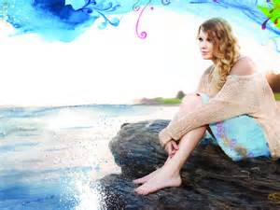
Taylor Swift
By Autumn

Slide 2
Why is this person famous?
She is famous because she is a singer and songwriter.

Slide 3
Early Life
She was born on December 13, 1989.
She was born in Wyomissing, Pennsylvania.
Her parents are Andrea and Scott.
She has a younger brother named Austin.
She went to school in Pottstown, Pennsylvania.
She loved reading and writing poetry.
She rode horses, played soccer, and sang to the music of Disney Movies.

Slide 4
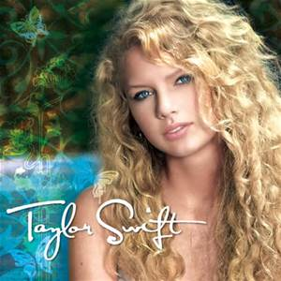
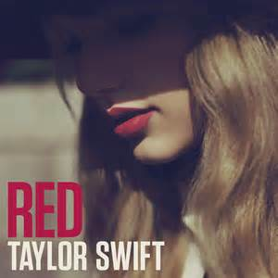
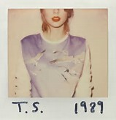
Adult Life
Her music career launched during the summer of 2006.
Her first album was Taylor Swift. It was released in 2006.
Taylor Swift has sold more than 3.5 million copies through 2011.

