Slide 1
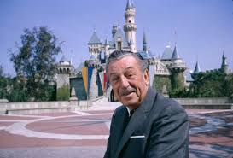
Walt Disney
By Audrey

Slide 2
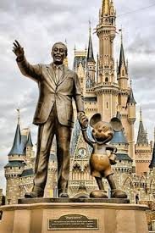
What is he famous for?
Walt is famous for creating Disney World.

Slide 3
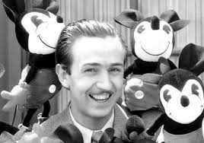
Early Life
Walt was born on December 5, 1901.
When Walt was young, he moved to a farm.
In 1917, the Disneys returned to Chicago.

Slide 4
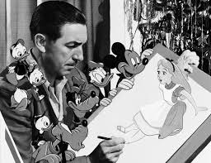
Character traits
Walt was creative and talented.

Slide 5
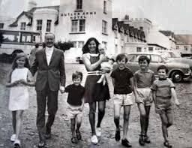
Fun facts
Walt is a famous artist.
He won many awards for his work.
Walt had 3 brothers and 1 sister.
Even after Walt’s death his work continued to be honored.
He moved to Kansas.
Walt died at age 65.

