Slide 1
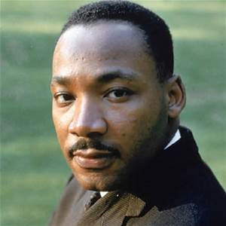
Martin Luther King Jr.
By: Alex

Slide 2
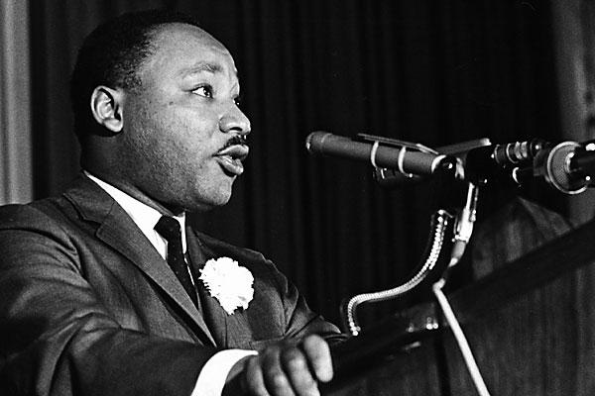
What is he famous for?
He helped change old laws.

Slide 3
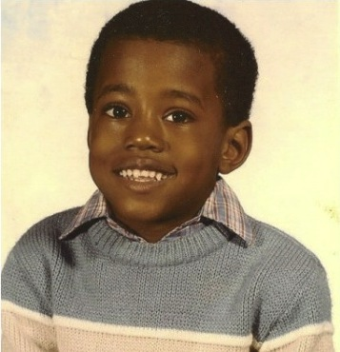
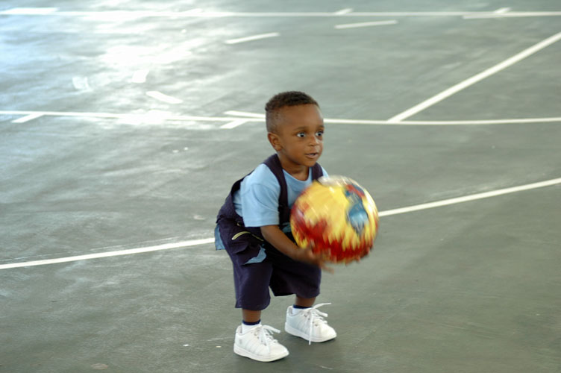
Early Life
He had a brother and a sister.

Slide 4
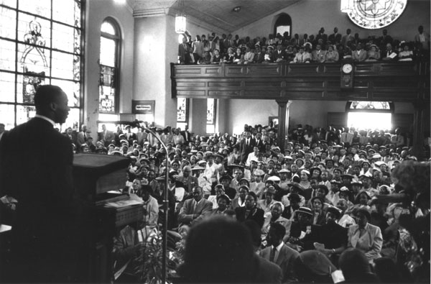
Fun Facts
He was a pastor.
His mom was a teacher.
He led a protest where people refused to ride the bus.

