Slide 1
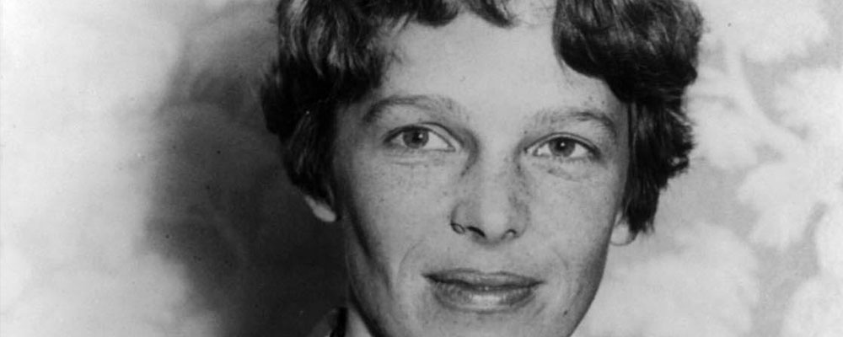
Amelia Earhart
By Aidan

Slide 2
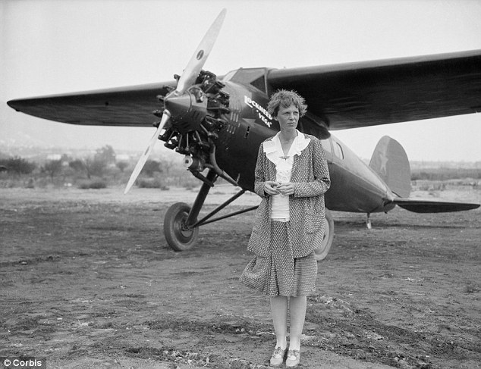
Why is this person famous?
She was the first woman to fly over the Atlantic Ocean.

Slide 3
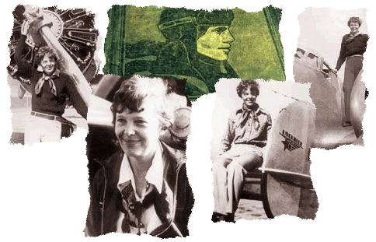
Birth and Family
Amelia was born on July 24, 1897.
She was born in Atchison, Kansas.
Her parents were Edwin Earhart and Amy Earhart.
Her sister was Grace Muriel.

Slide 4
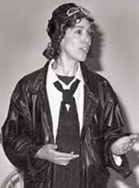
Early Life
She was the first woman to fly over the Atlantic Ocean.
She was eleven when she first saw an air plane.
She quit school to take care of the injured people who came back from the war.

Slide 5
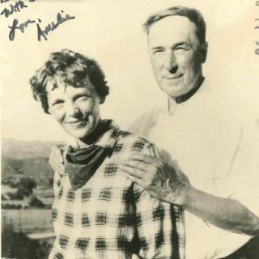
Adult Life
She sold her plane to by a car to drive her mom to their new house.
She also got married to her publisher, George Putman.
Somewhere in the ocean she and her navigator disappeared somewhere and never were found.

