Slide 1
Michelle Kwan
By Abi

Slide 2
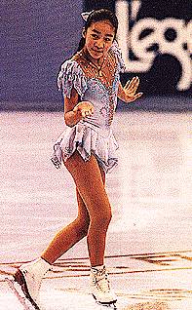
What is she famous for?
She was the youngest Olympic skater.
She finished in second place in the U.S. Figure skating championships.
She is a two time Olympic medalist, a five time world champion, and a nine-time US champion.

Slide 3
Early life
She was the youngest of her family.
She was 8 when she started to skate.
She has an older brother and sister.

Slide 4
Character Traits
She was a hard worker.
She never gave up.

Slide 5
Fun Facts
Her goal at a very early age was world competition.
Michelle waved to the crowd after being awarded a gold medal.
Michelle skated in the 1995 Nationals to a silver medal.

