Slide 1
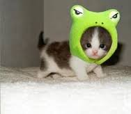
Rhode Island
Olivia

Slide 2
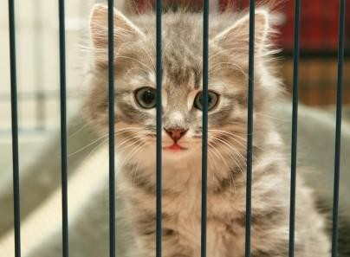
A is for Animals
cat

Slide 3
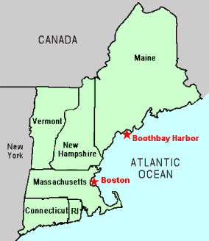
B is for Border States
Massachusetts

Slide 4
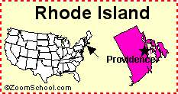
C is for Capitol
Providence

Slide 5
D is for Distance
1,212 miles

Slide 6
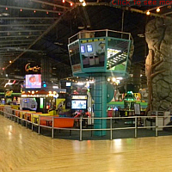
E is for Entertainment
USA skates

Slide 7
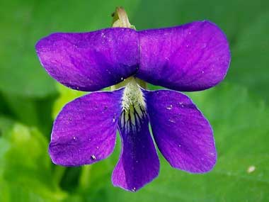
F is for Flag and Flower
Rhode Island Flag violet

Slide 8
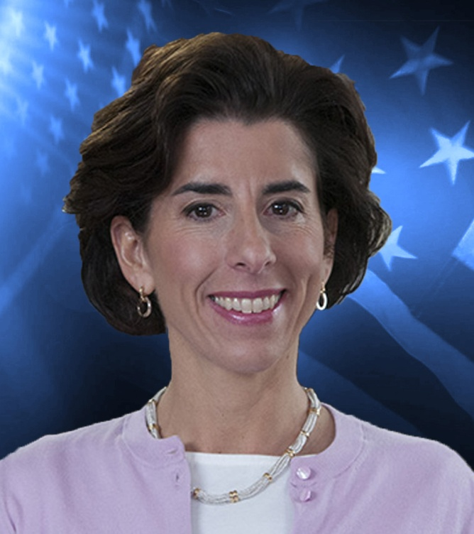
G is for Governor
Gina Raimondo

Slide 9
H is for History
Great depression

Slide 10
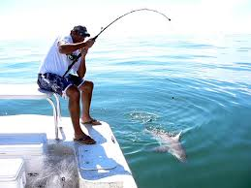
I is for Industries
Fishing

Slide 11
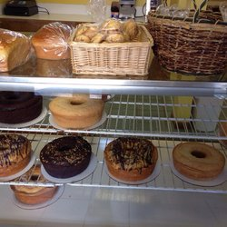
J is for Jobs
bakery

Slide 12
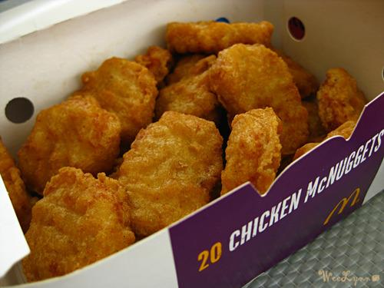
K is for Kinds of Food
Chicken nuggets

Slide 13
L is for Landmarks
Roger Williams Park Zoo

Slide 14
M is for Motto
Hope

Slide 15
N is for Natural Resources
Recycling
Trash disposal
Plastic recycling

Slide 16
O is for Origin of State
Named for isle of Rhodes or its red clay.

Slide 17
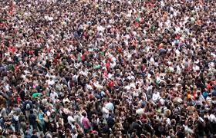
P is for Population
1.055 million people

Slide 18
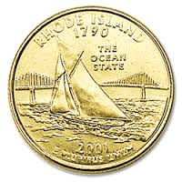
Q is for Quarter

Slide 19
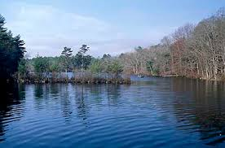
R is for Rivers and Lakes
Flat River

Slide 20
S is for Sports
PawSox
Providence Bruins

Slide 21
T is for Tree
Red maple tree

Slide 22
U is for University

Slide 23
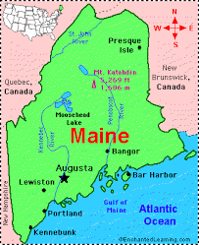
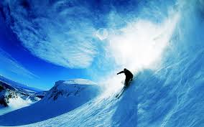
V is for Vacation Spots
Maine
New Hampshire

Slide 24
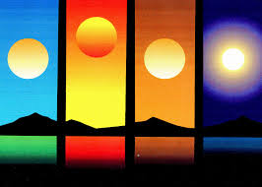
W is for Weather and Climate
The weather in the summer is hot, winter is cold, fall is chilly and spring is warm.

Slide 25
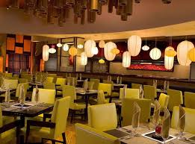
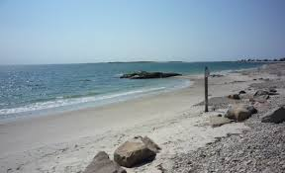
X is for eXciting facts
There is a lot of beaches.
There are many good restaurants.

Slide 26
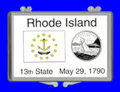
Y is for Year of Statehood
May 29,1790

Slide 27
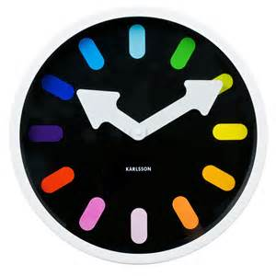
Z is for Time Zone
Eastern standard Time Zone

