Slide 1
My Rhode Island ABC Book
By
Lincoln

Slide 2
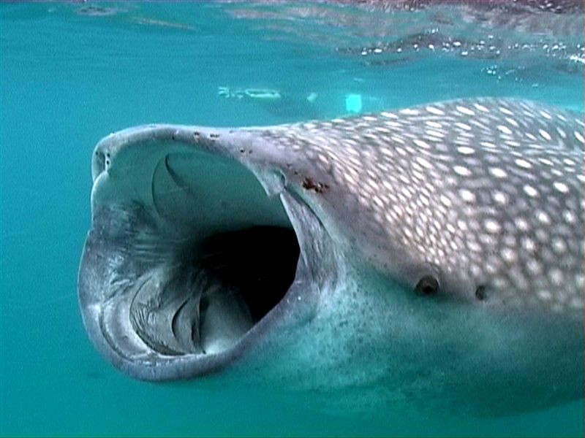
A is for Animals
Whale Sharks

Slide 3
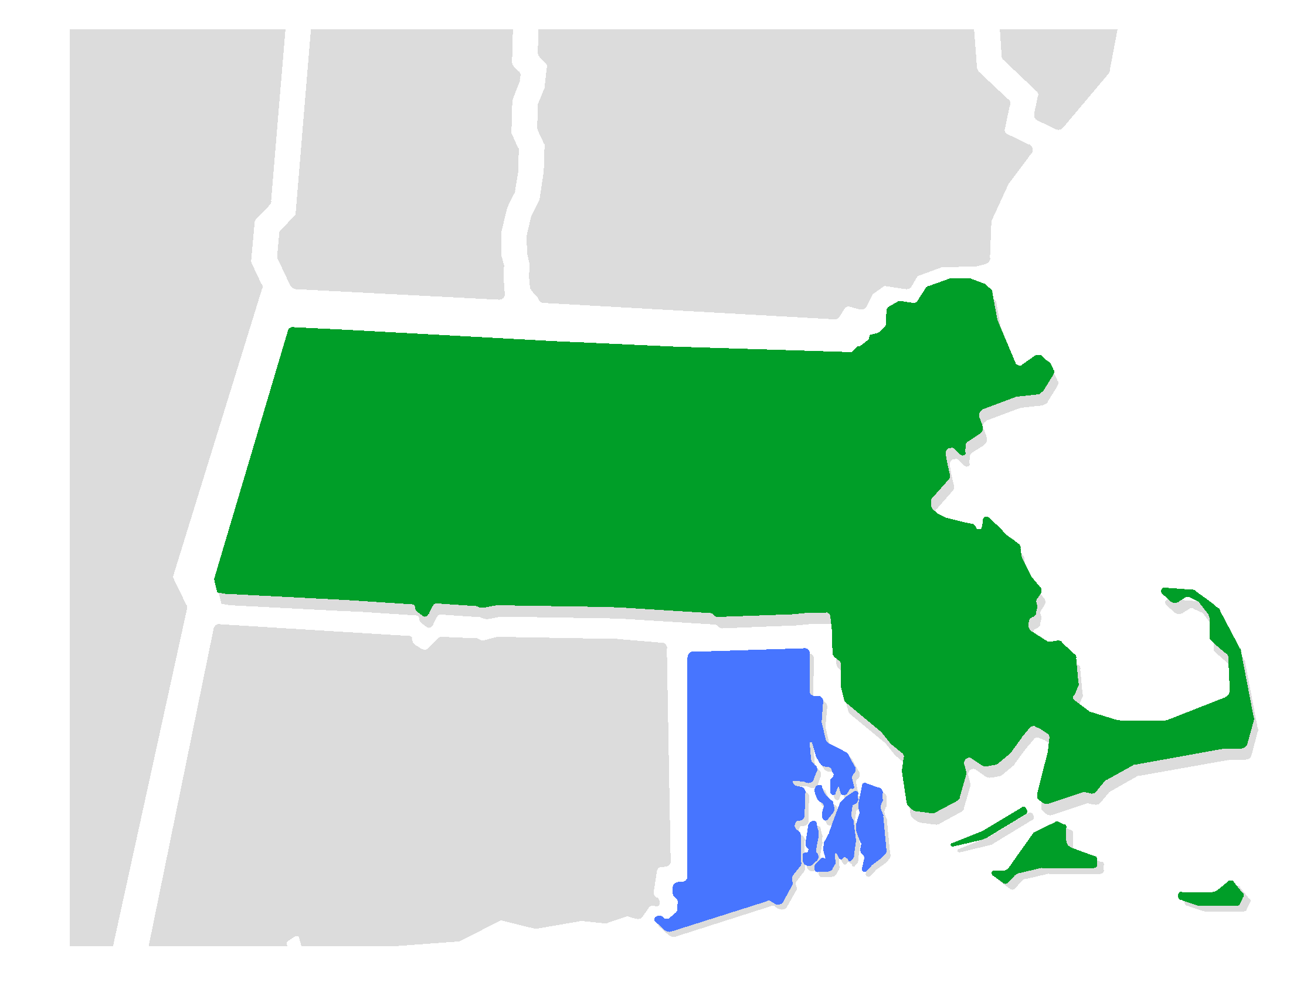
B is for Border States
Massachusetts and Connecticut

Slide 4
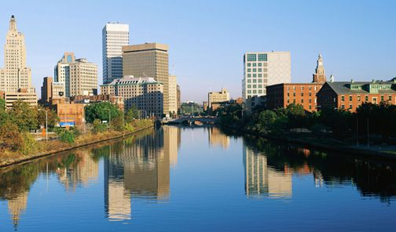
C is for Capitol
Providence

Slide 5
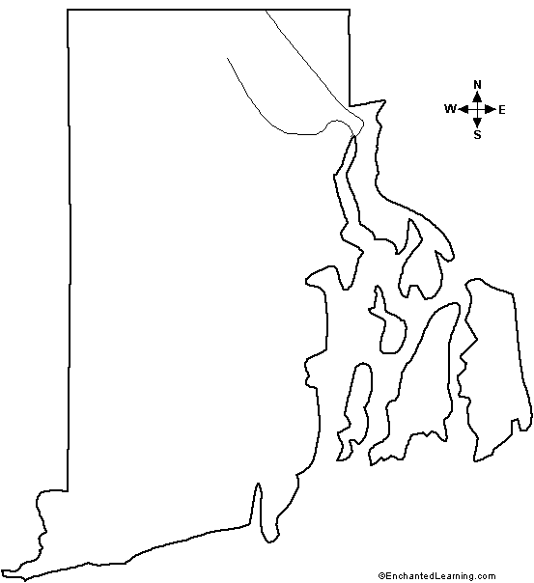
D is for Distance
1,545 square miles

Slide 6
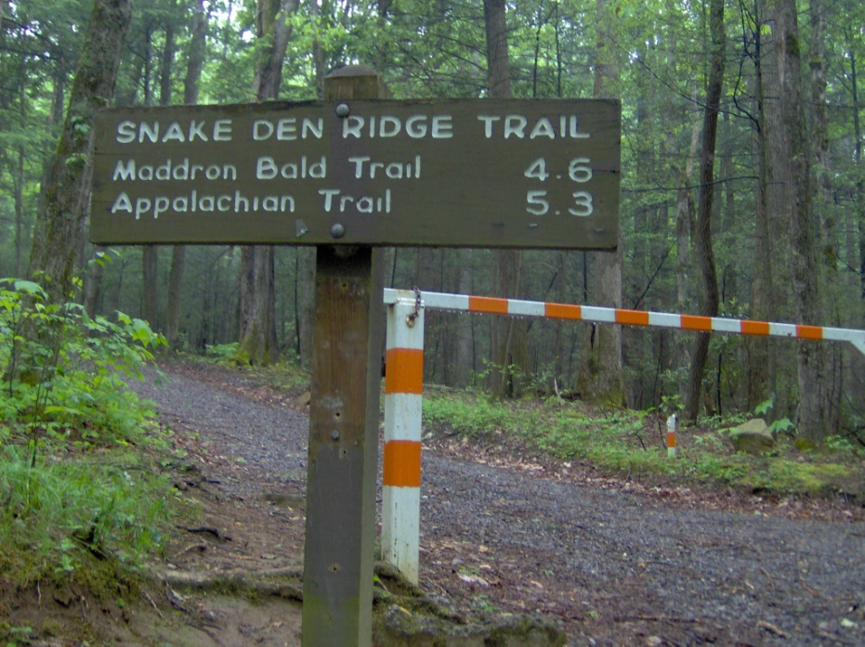
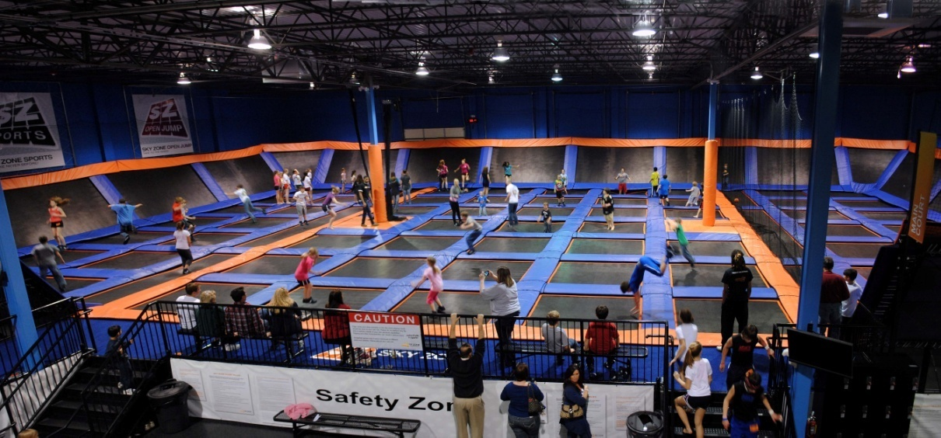
E is for Entertainment
Snake Den
Sky Zone

Slide 7
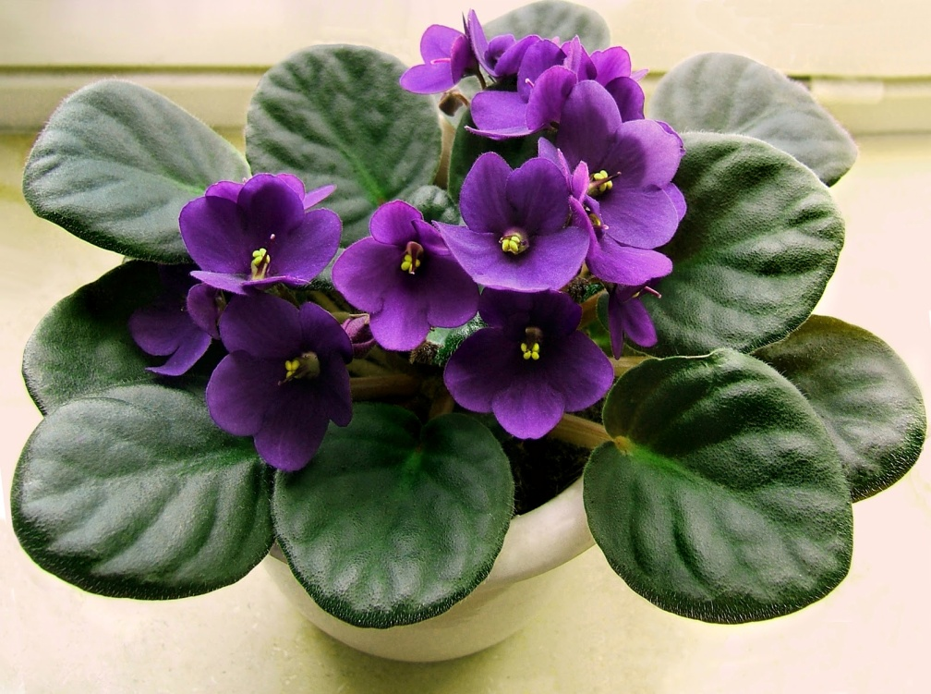
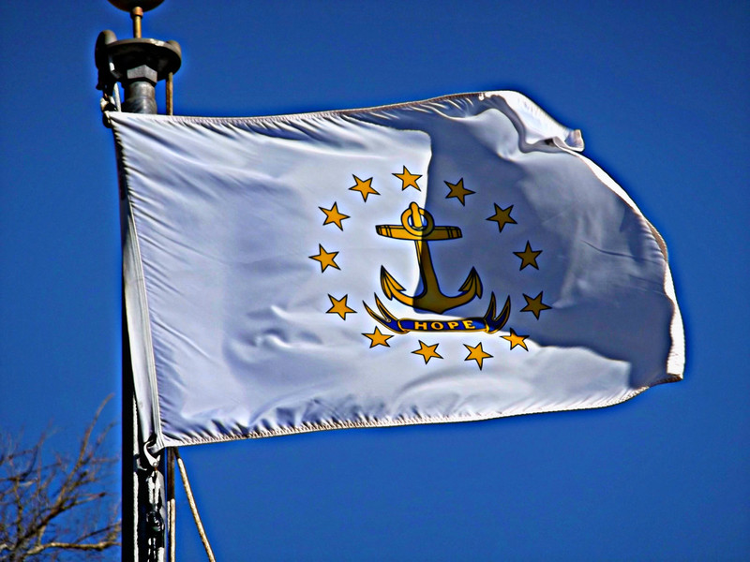
F is for Flag and Flower
The state flower is the violet

Slide 8
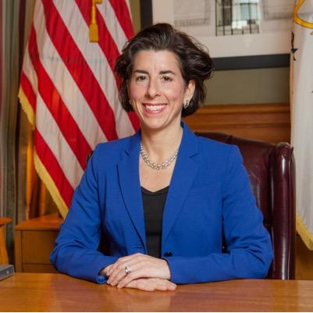
G is for Governor
Gina Raimondo

Slide 9
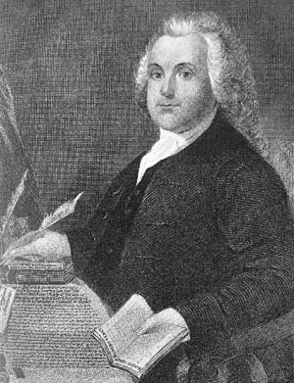
H is for History
Roger Williams was once a governor of Rhode Island.

Slide 10
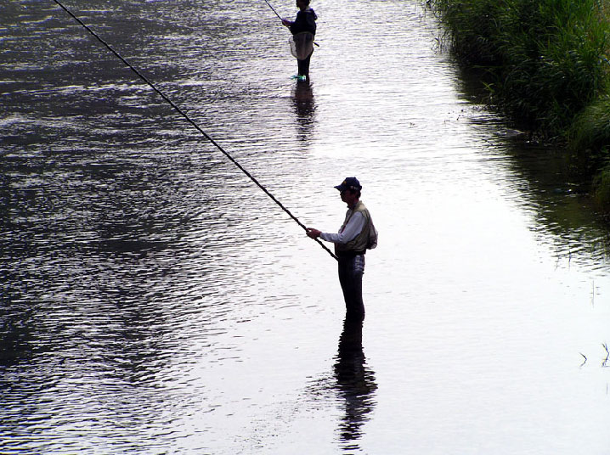
I is for Industries
Fishing

Slide 11
J is for Jobs
Toys R Us
Walmart

Slide 12
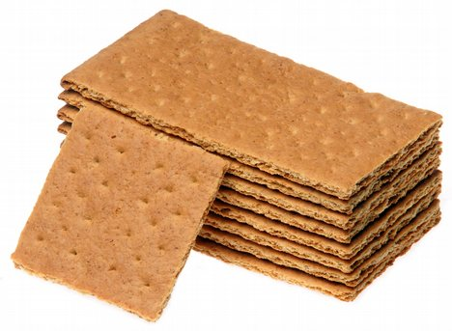
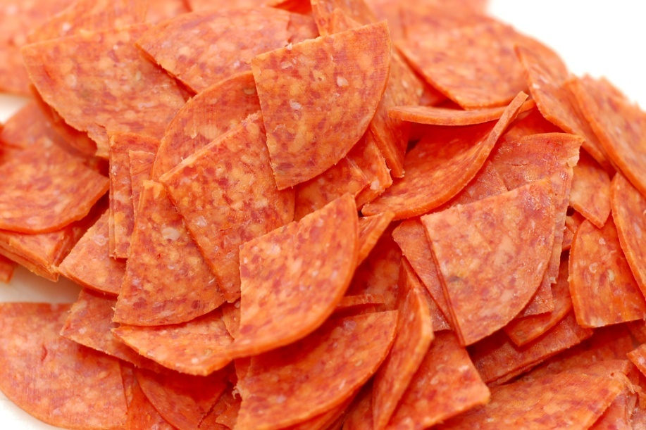
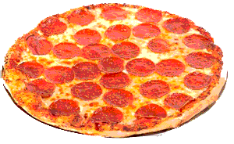
K is for Kinds of Food
Pepperoni
Pizza
Saltines and Graham Crackers

Slide 13
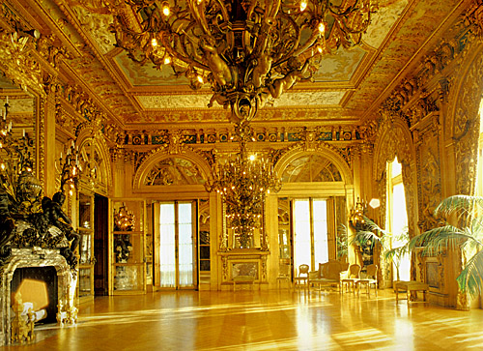
L is for Landmarks
Marble House

Slide 14
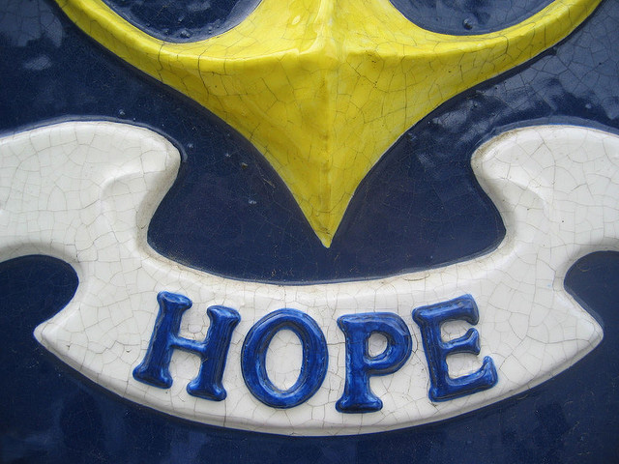
M is for Motto
The Rhode Island state motto is hope.

Slide 15
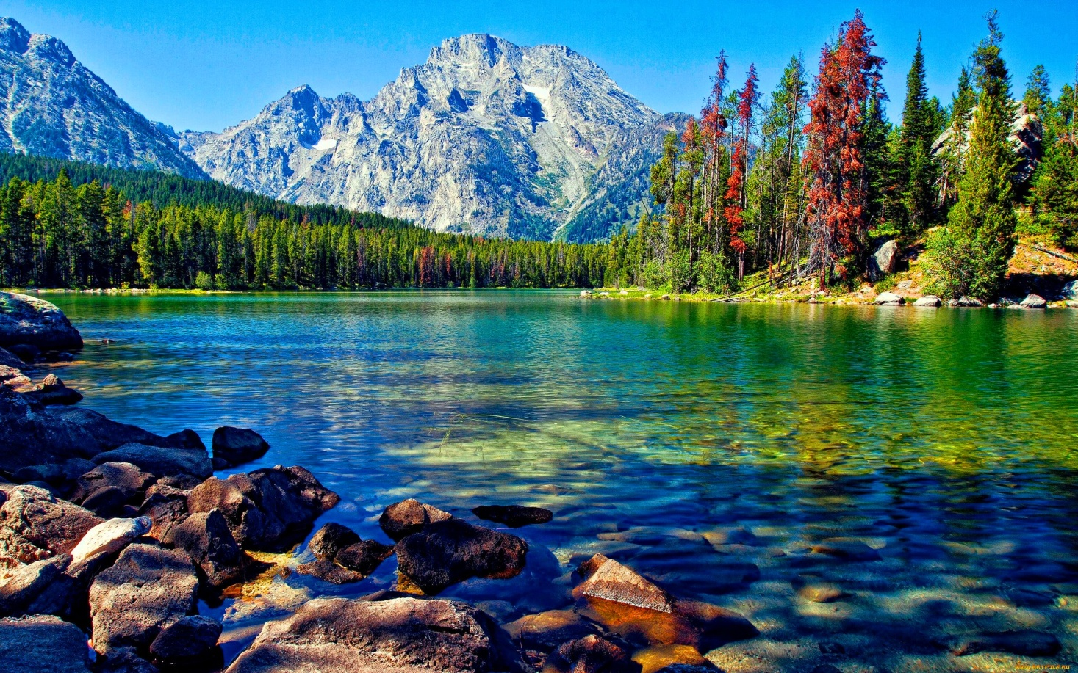
N is for Natural Resources
Water

Slide 16
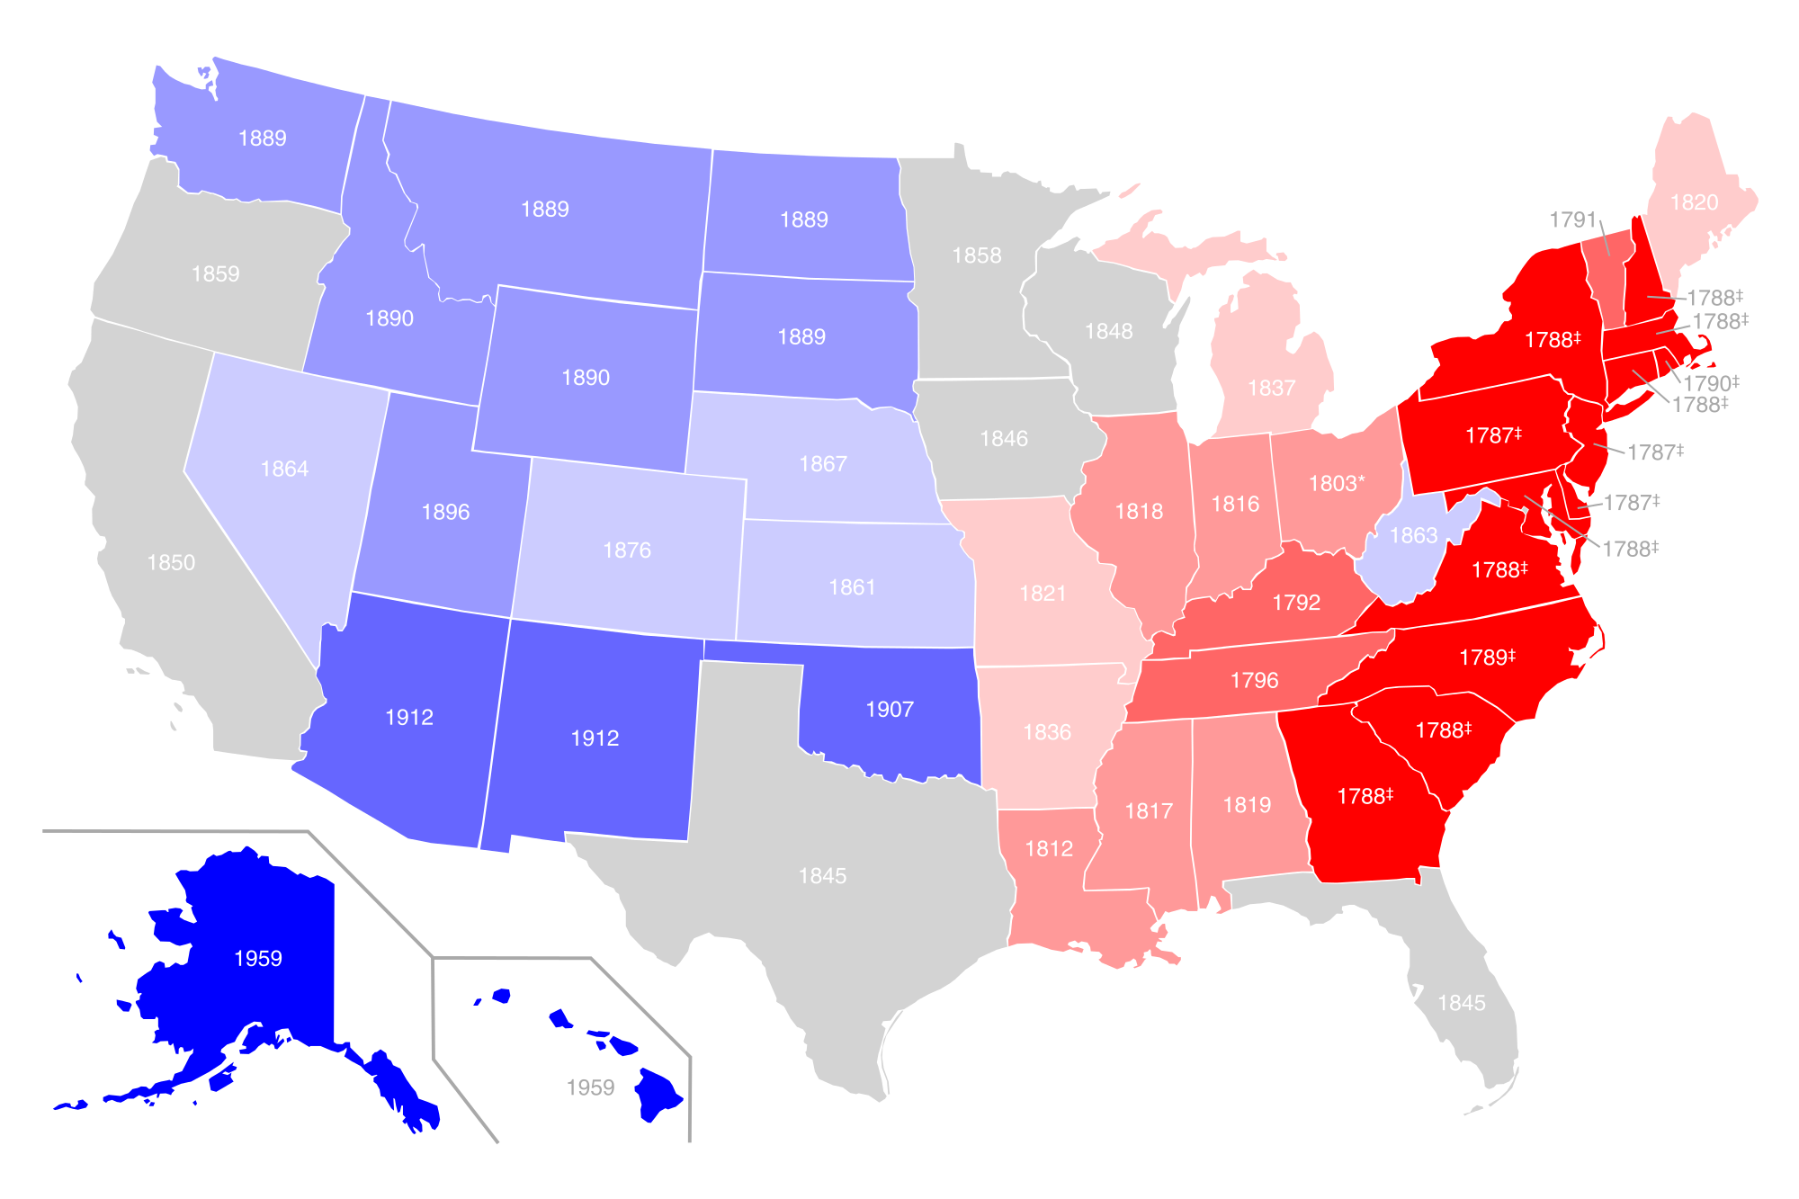
O is for Origin of State
Rhode Island was the 13th state.

Slide 17
P is for Population
The population of Rhode Island is 1.055 million.

Slide 18
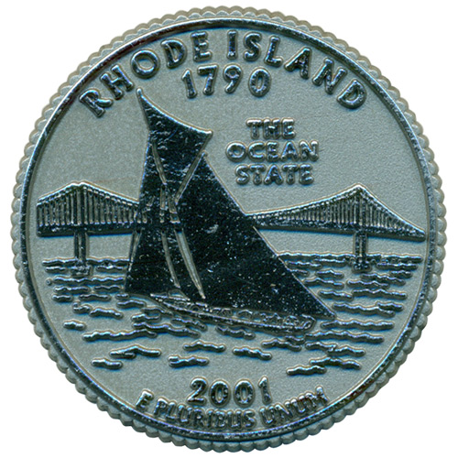
Q is for Quarter

Slide 19
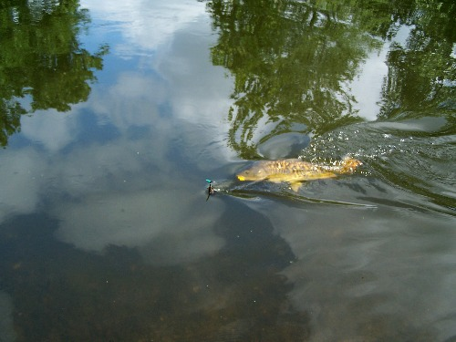
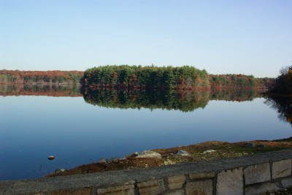
R is for Rivers and Lakes
The Blackstone River
Scituate Reservoir

Slide 20
S is for Sports
Soccer

Slide 21
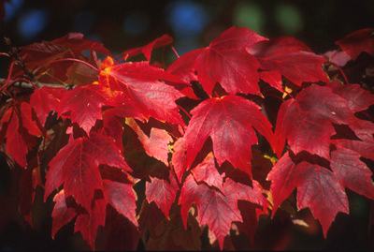
T is for Tree
The Rhode Island state tree is the red maple.

Slide 22
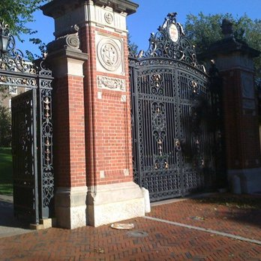
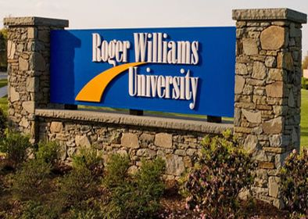
U is for University
Roger Williams University
Brown College

Slide 23
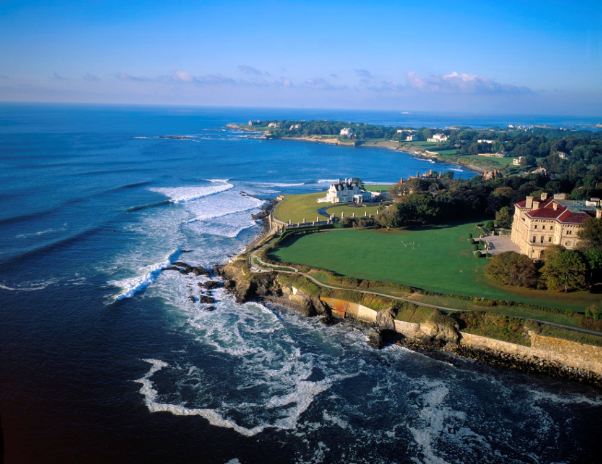
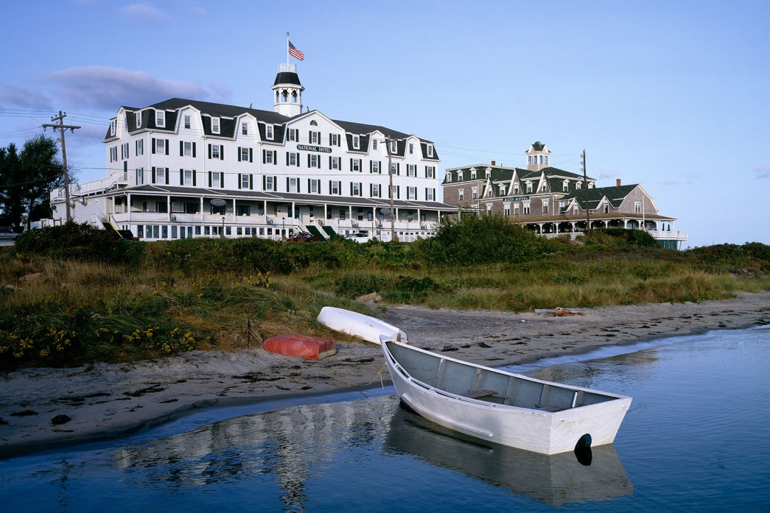
V is for Vacation Spots
Block Island
Newport

Slide 24
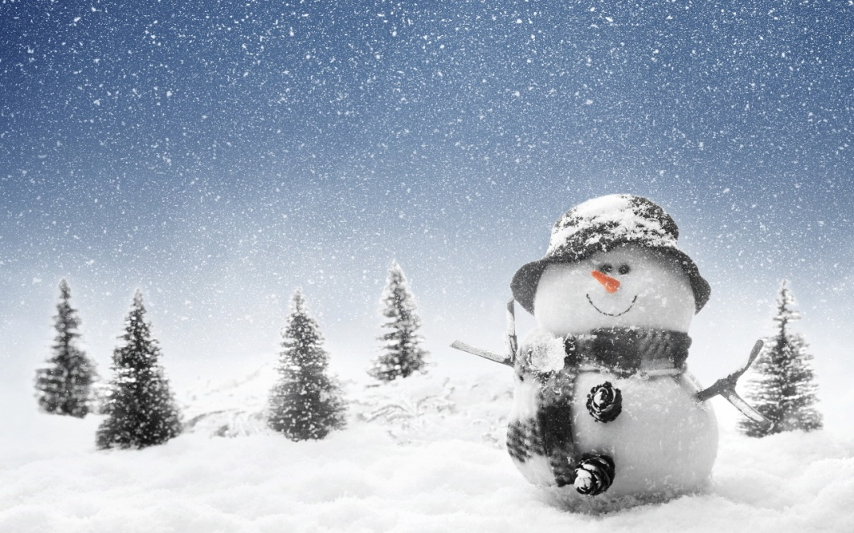
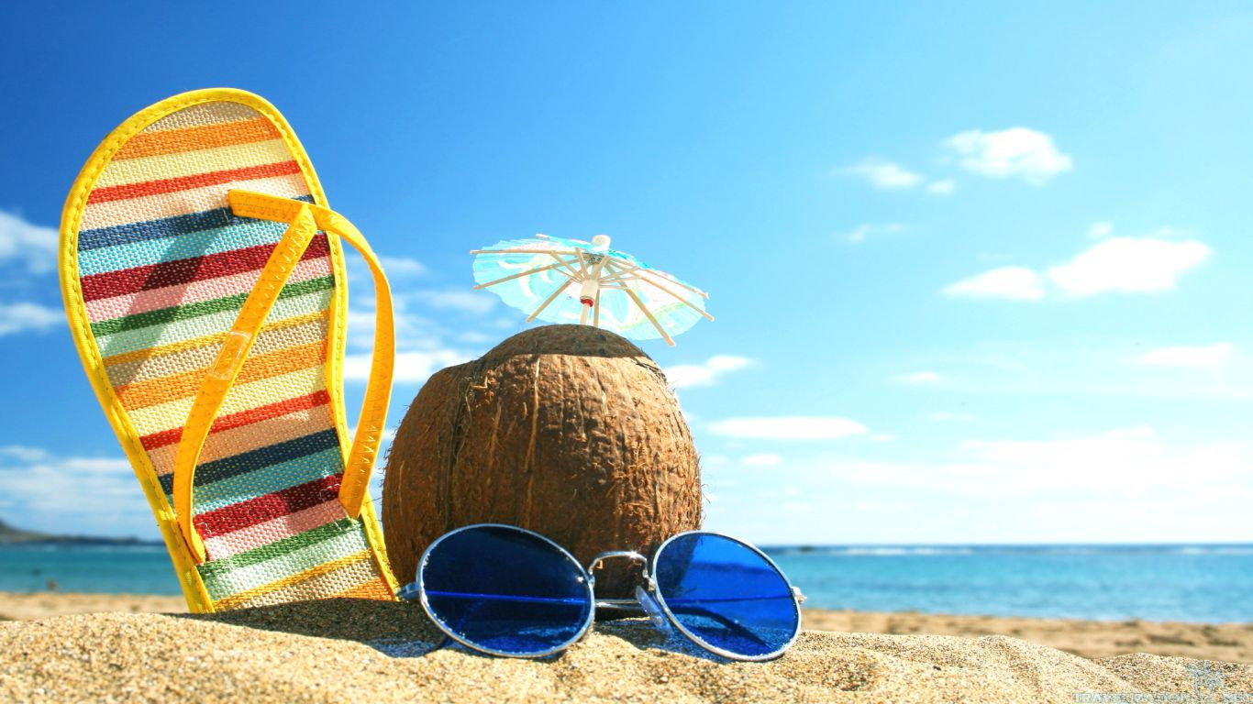
W is for Weather and Climate
Rhode Island has long winters and short summers.

Slide 25
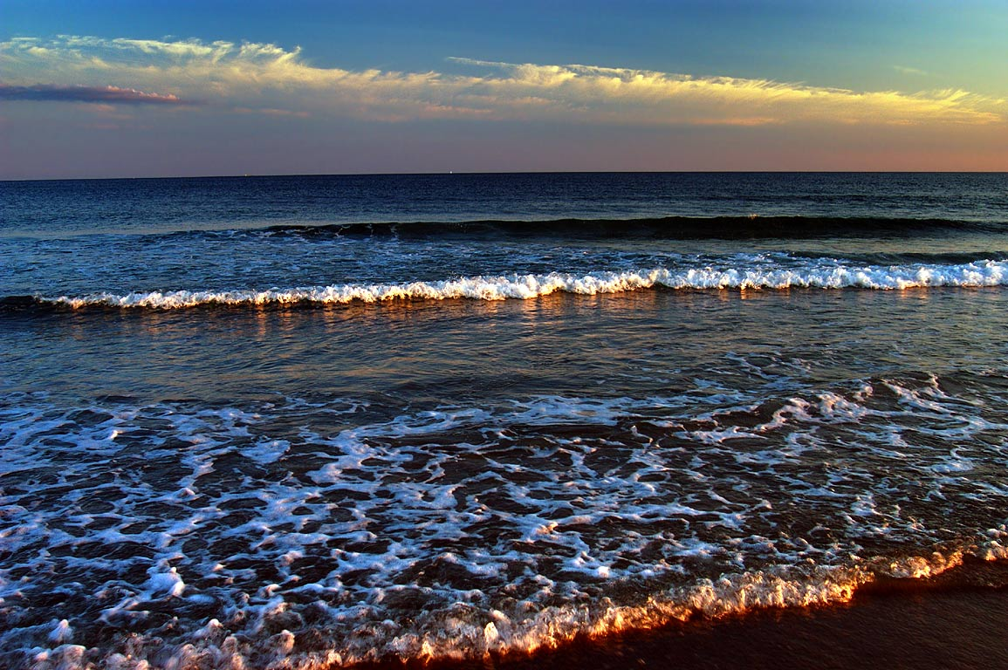
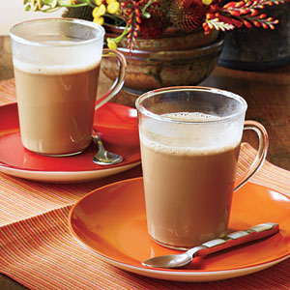
X is for eXciting facts
There are many beaches in Rhode Island.
The official drink of Rhode Island is coffee milk.

Slide 26
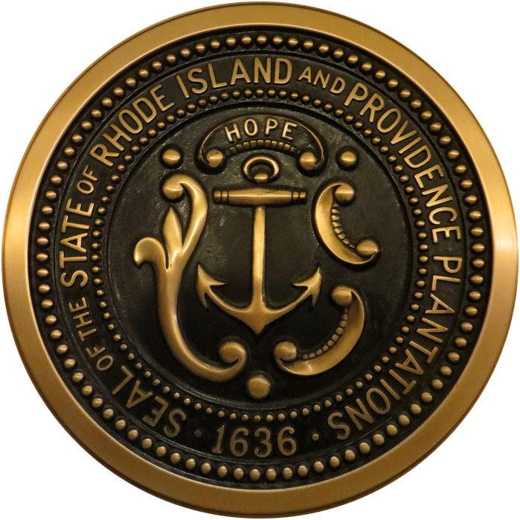
Y is for Year of Statehood
Rhode Island was made a state in 1790.

Slide 27
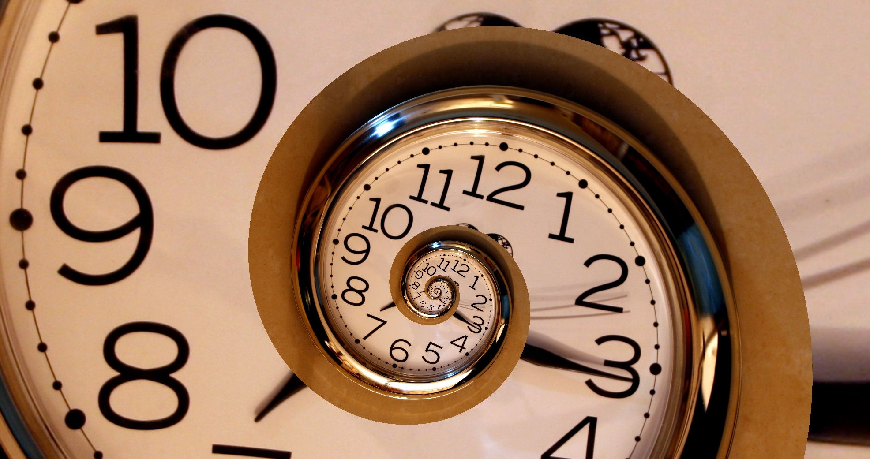
Z is for Time Zone
Rhode Island is in the Eastern Standard Time zone.

