Slide 1
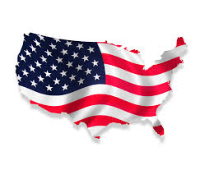
My RI ABC Book
By:Hanna

Slide 2
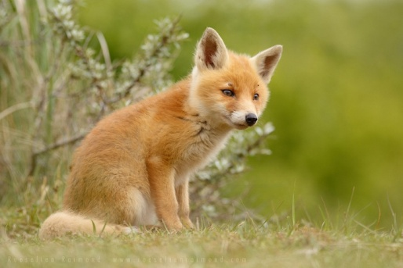
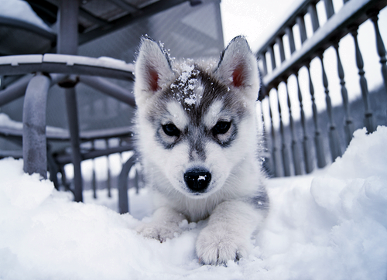
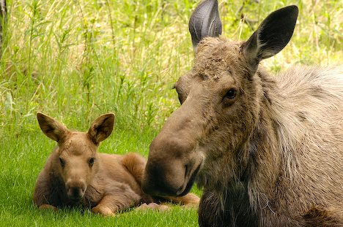
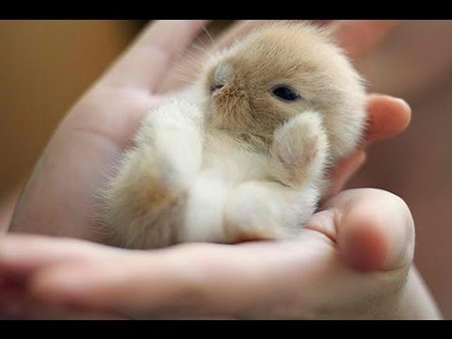
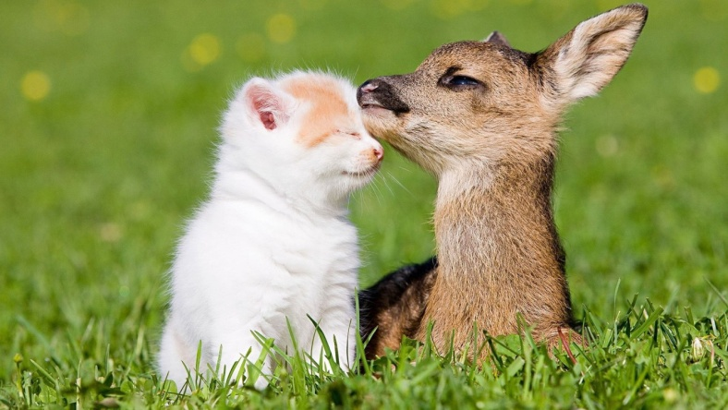
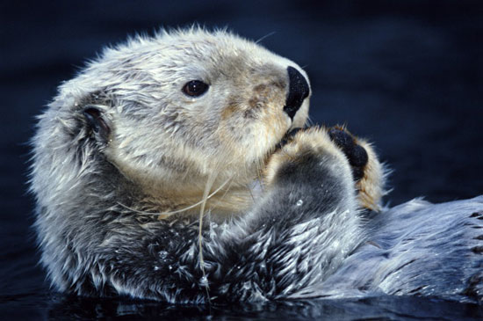
A is for Animals
Foxes
Sea Otters
Moose
Deer
Bunnies
Puppies

Slide 3
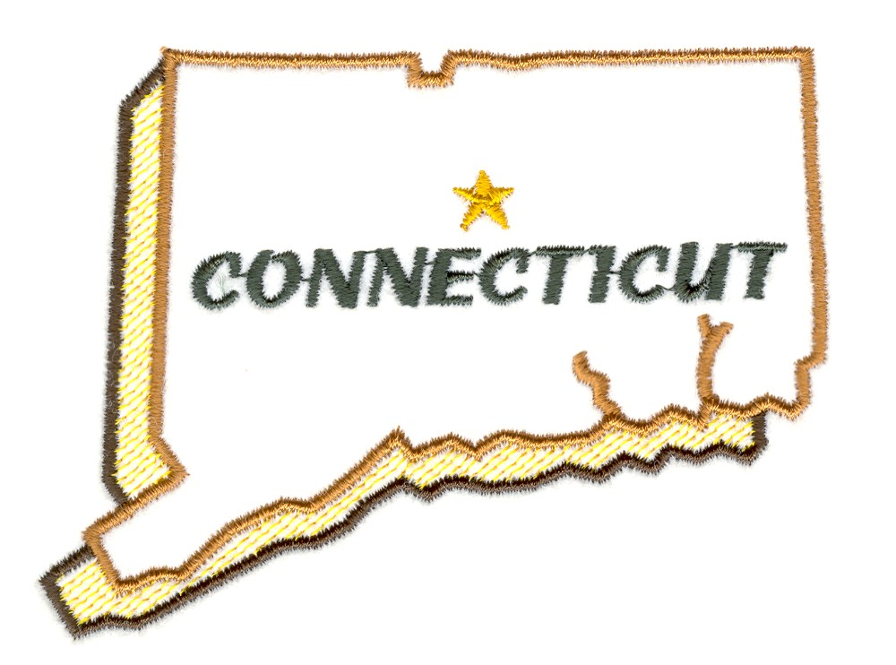
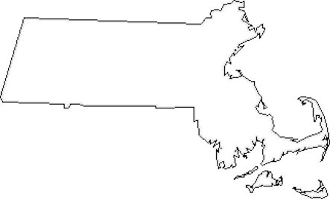
B is for Border States
Massachusetts
Connecticut

Slide 4
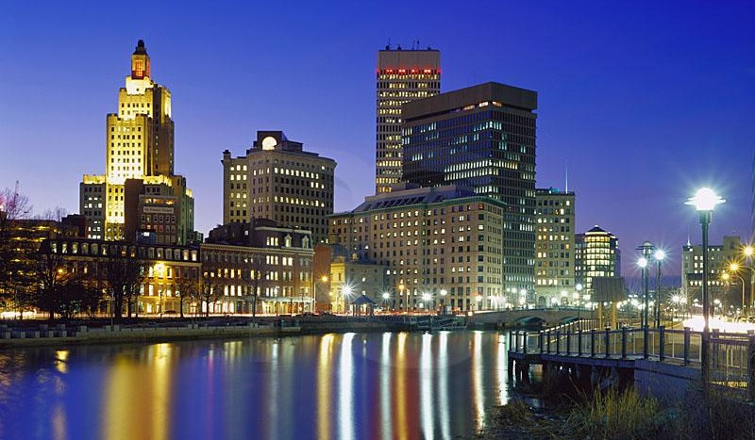
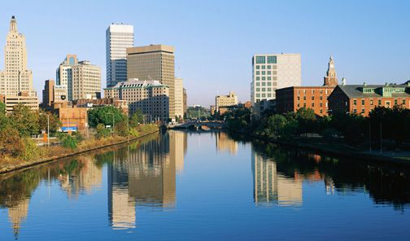
C is for Capitol
Providence

Slide 5
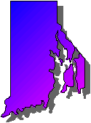
D is for Distance
1,545 square miles

Slide 6
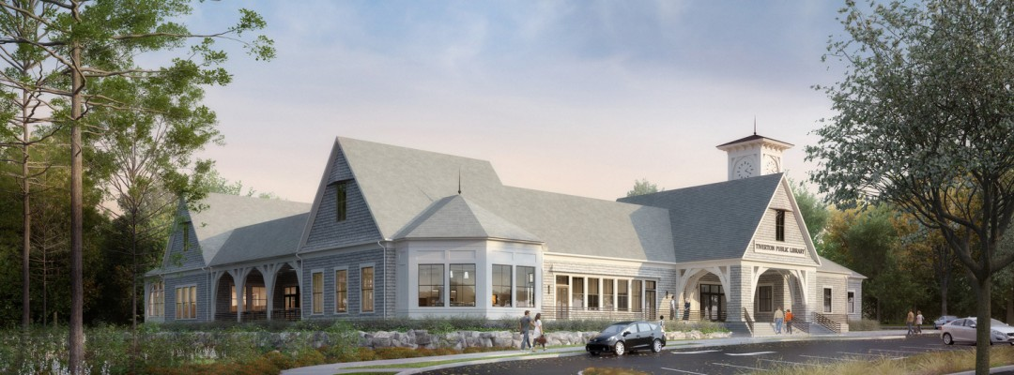
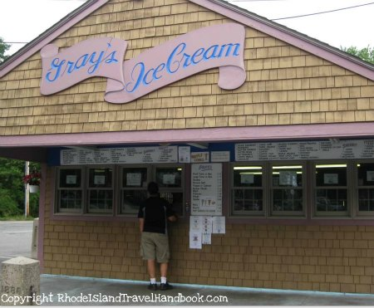
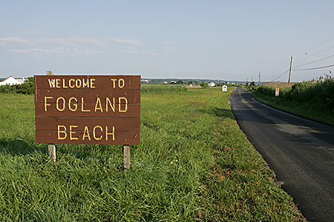
E is for Entertainment
Fogland beach
Gray’s ice cream
Tiverton Library

Slide 7
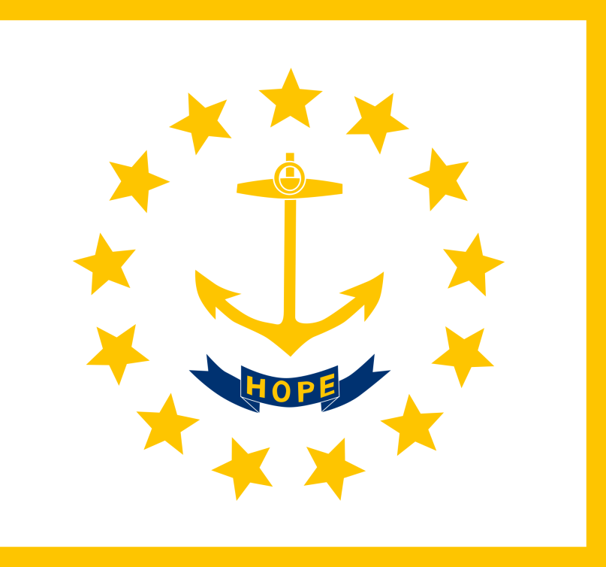
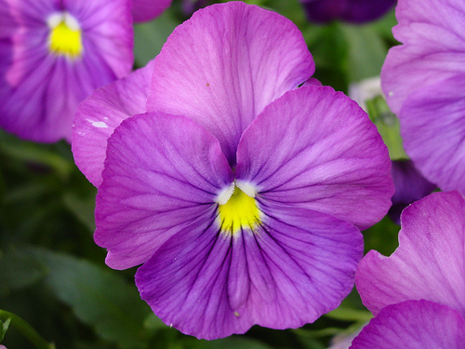
F is for Flag and Flower
The state flower is the violet.

Slide 8
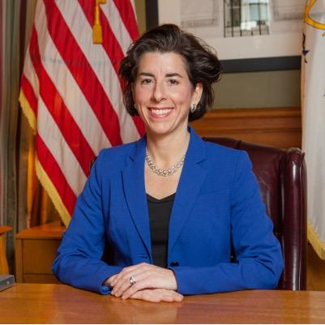
G is for Governor
The governor of Rhode Island is Gina Raimondo.

Slide 9
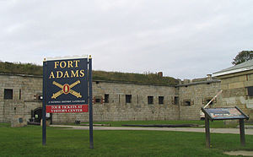
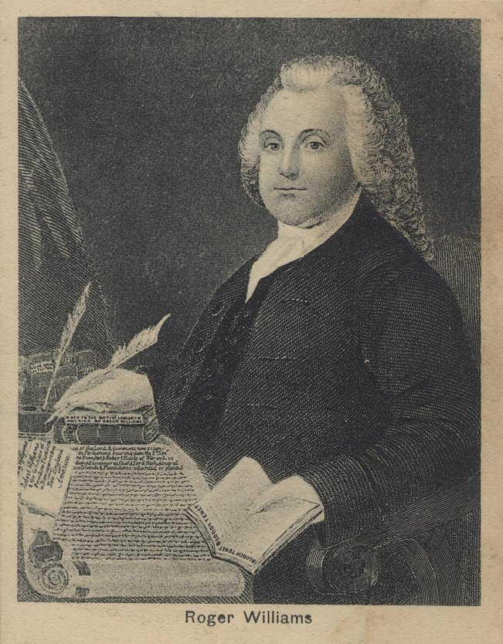
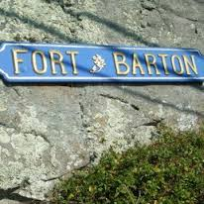
H is for History
Roger Williams
Fort Barton
Fort Adams

Slide 10
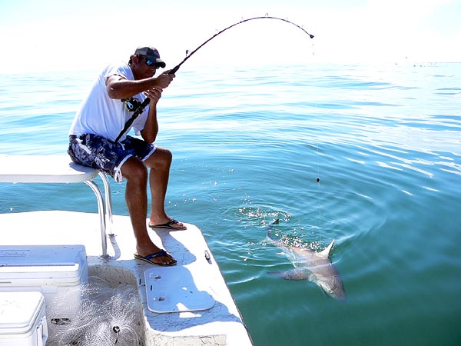
I is for Industries
Fishing

Slide 11
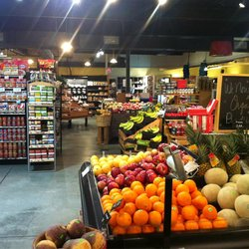
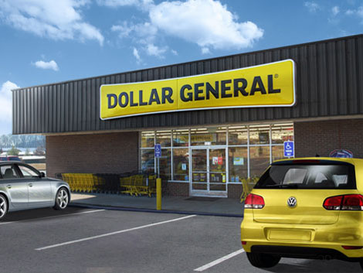
J is for Jobs
Dunkin Donuts
Tom’s Market
Dollar General

Slide 12
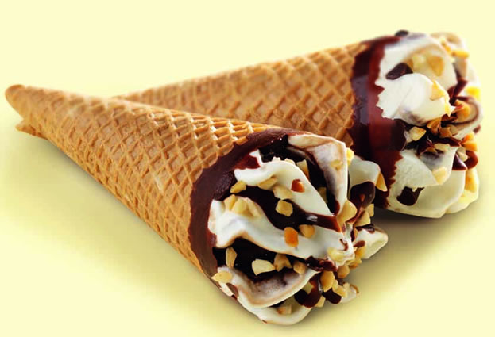
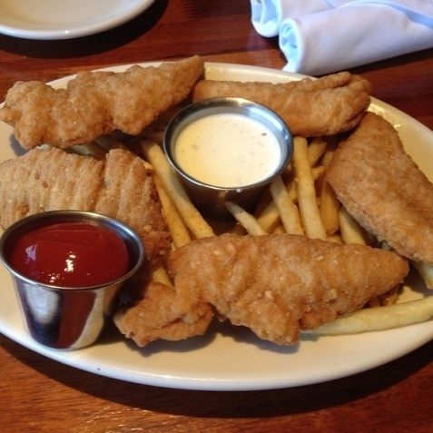
K is for Kinds of Food
Ice cream
Chicken tenders

Slide 13
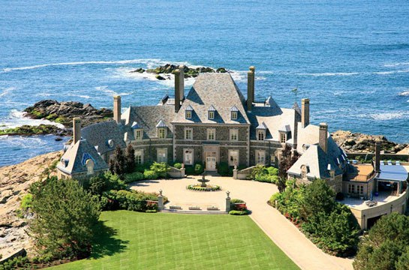
L is for Landmarks
Newport Mansions

Slide 14
M is for Motto
The Rhode Island state motto is hope.

Slide 15
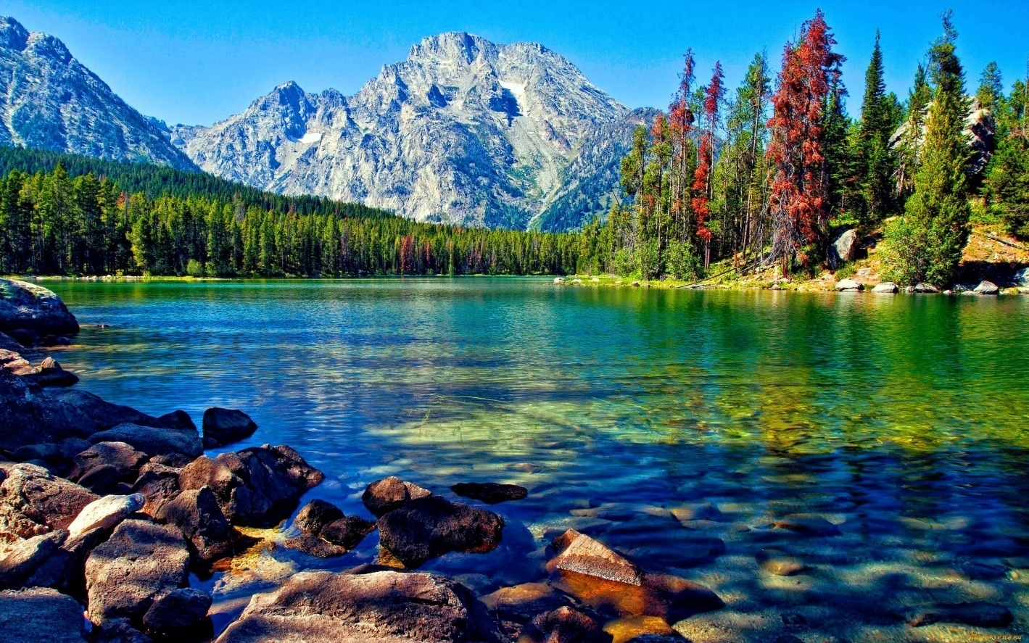
N is for Natural Resources
Water

Slide 16
O is for Origin of State
Roger Williams was Governor of the Colony 1654 through 1658

Slide 17
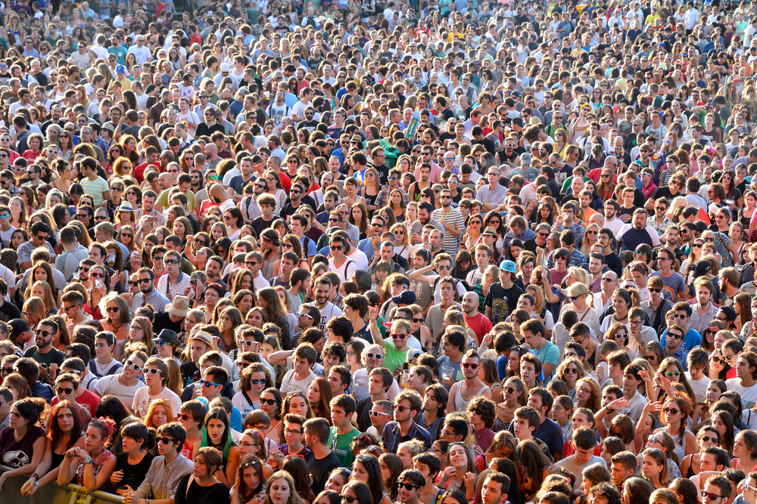
P is for Population
The population of Rhode Island is 1.055 million.

Slide 18
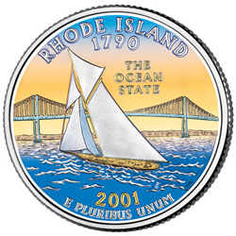
Q is for Quarter

Slide 19
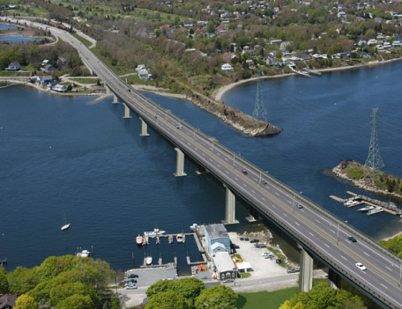
R is for Rivers and Lakes
Sakonnet River

Slide 20
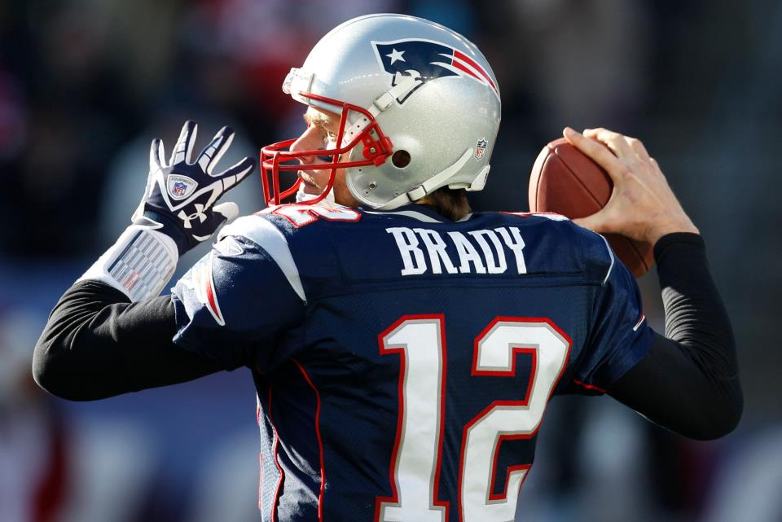
S is for Sports
New England Patriots

Slide 21
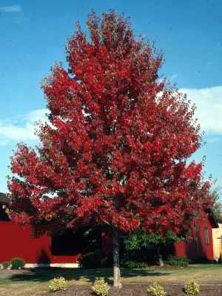
T is for Tree
The Rhode Island state tree is the red maple.

Slide 22
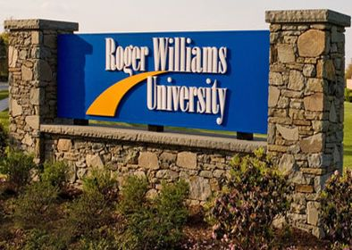
U is for University
Roger Williams University

Slide 23
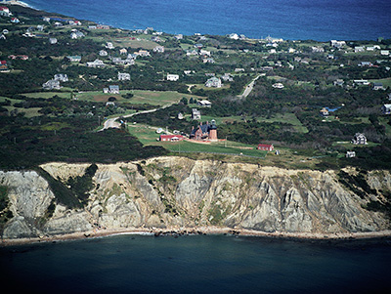
V is for Vacation Spots
Block Island

Slide 24
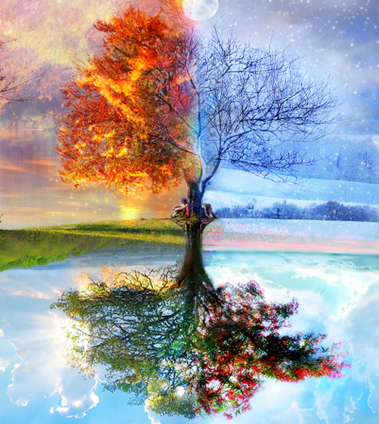
W is for Weather and Climate
The weather in Rhode Island changes as the seasons go by. Rhode Island sees all four seasons.

Slide 25
X is for eXciting facts
Rhode Island is the smallest state in size in the United States. It covers an area of 1,214 square miles. Its distances North to South are 48 miles and East to West 37 miles.

Slide 26
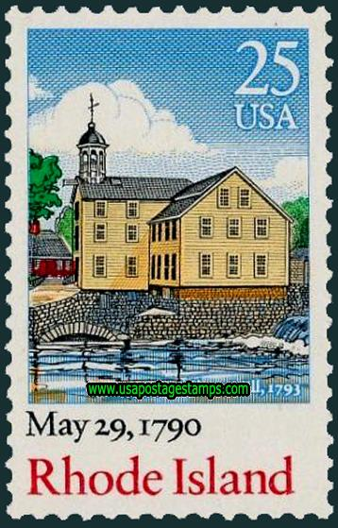
Y is for Year of Statehood
May 29 1790

Slide 27
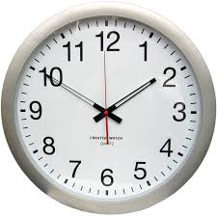
Z is for Time Zone
Eastern Time Zone (UTC-05:00)

